Slide 1
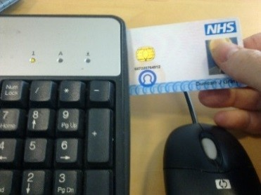
Summary Care Records – Business As Usual Process
1
2
3
4
Pharmacy professional requires access to SCR
Pharmacy professional checks guidance on NHS Digital website
Completes online CPPE training
Completes role request form on NHS Digital website
NHS Digital checks AUA in place and CPPE assessment passed
Requests SCR role addition to smartcard from RA
Confirms to pharmacy professional role request made
RA adds SCR role to smartcard
5
Pharmacy professional accesses SCR

Slide 2
Pharmacy
NHSD
RA
Pharm.
Pharmacy professional (PP) needs SCR access
PP views SCR guidance on NHSD website
PP completes online CPPE training
PP fills out SCR role request form on NHSD website
NHSD checks AUA in place and CPPE assessment
NHSD requests SCR role addition from RA
NHSD confirms to PP
SCR role request made
RA checks PO in place and add on SCR role
RA confirms SCR role added to NHSD
PP can now access SCR
Pharmacy Professional (PP) SCR request process for pharmacy live with SCR
Pharmacy
NHSD
RA
Pharm.
Individual needs SGL access
Individual views SGL guidance on NHSD
website
Individual completes training on NHSD website
Individual fills out SGL role request form on NHSD website
NHSD checks completion of SGL training
NHSD requests SGL role addition from RA
NHSD confirms to individual SGL role request made
RA adds on SGL role
RA confirms SGL role added to NHSD
SGL can now access alert viewer
SCR Governance Lead (SGL) role request process for pharmacy live with SCR
Pharmacy
NHSD
RA
Pharm.
Pharmacy needs to go live with SCR
Pharmacy manager reads go-live guidance on NHSD
AUA form completed on NHSD website
Roles requested for PP+SGL on NHSD website
NHSD checks AUA in place and CPPE assessment
NHSD requests SCR & SGP role additions from RA
NHSD confirms to manager SCR & SGL role requests made
RA adds on SCR & SGL roles
RA confirms roles added to NHSD
Pharmacy can now go live with SCR
New Pharmacy SCR request process
Pharmacy
NHSD
NHSD RA
Pharm.
Locum needs SCR access
Locum views SCR guidance on NHSD website
Locum completes online CPPE training
Locum fills out SCR role request form on NHSD website
NHSD checks CPPE & proof of 5F status
NHSD requests SCR 5F access from NHSD RA
NHSD confirms to locum 5F SCR role request made
Central Access team adds on 5F SCR role
Role added confirmed back to NHSD
Locum can access SCR
5F Locum PP SCR request process
Summary Care Records BAU Process Scenarios

